Slide 1
Important Topics Added to Chapter 1
Uncertainty in Measurements
&
Significant Digits

Slide 2
Uncertainty in Measurements
A measurement is a number with a unit attached.
It is not possible to make exact measurements, and all measurements have uncertainty.
We will generally use metric system units. These include:

Slide 3
Uncertainty in Measurements
the meter, m, for length measurements
the gram, g, for mass measurements
the liter, L, for volume measurements

Slide 4
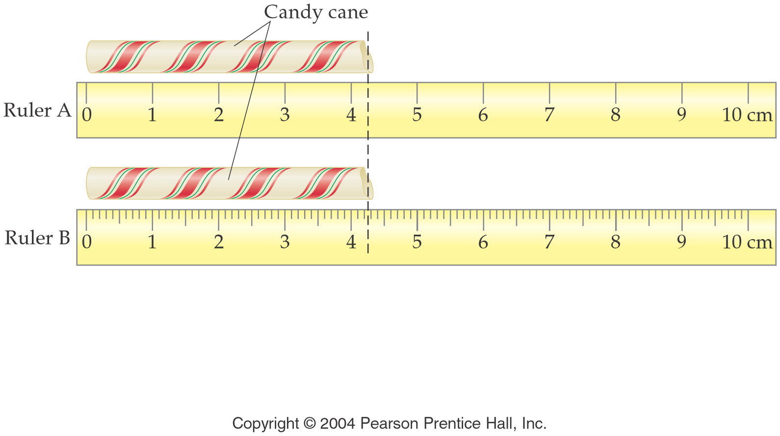
Uncertainty in Length
Ruler A: 4.2 ± 0.1 cm; Ruler B: 4.25 ± 0.05 cm.
Ruler A has more uncertainty than Ruler B.
Ruler B gives a more precise measurement.

Slide 5
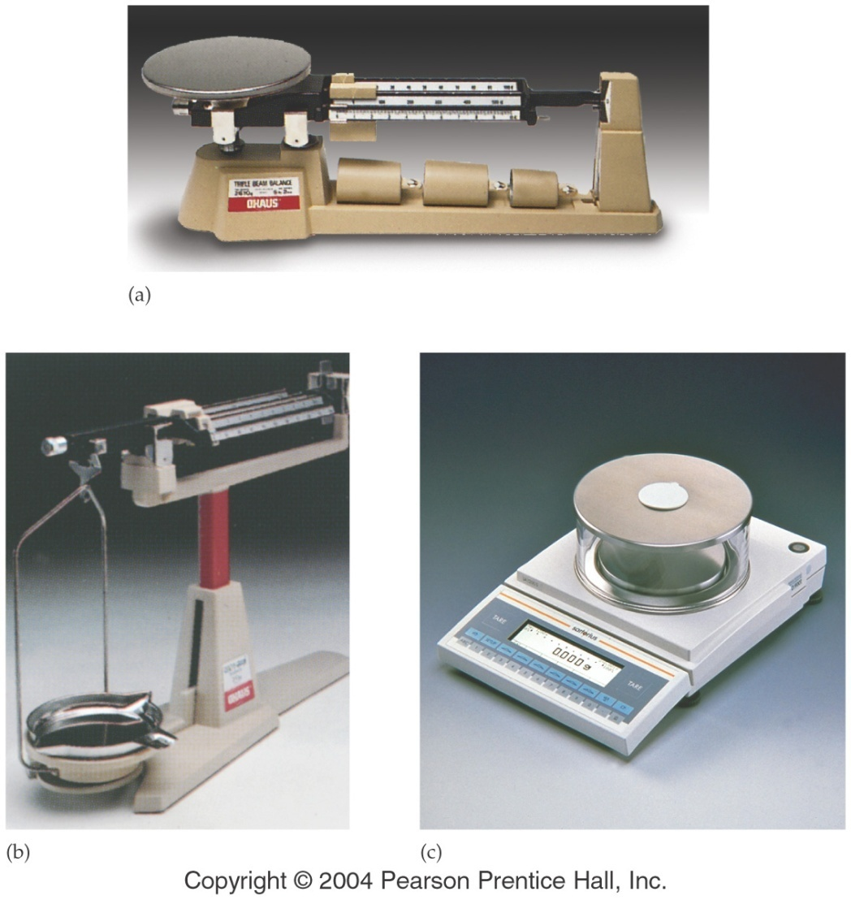
Mass Measurements
The mass of an object is a measure of the amount of matter it possesses.
Mass is measured with a balance and is not affected by gravity.
Mass and weight are not interchangeable.

Slide 6
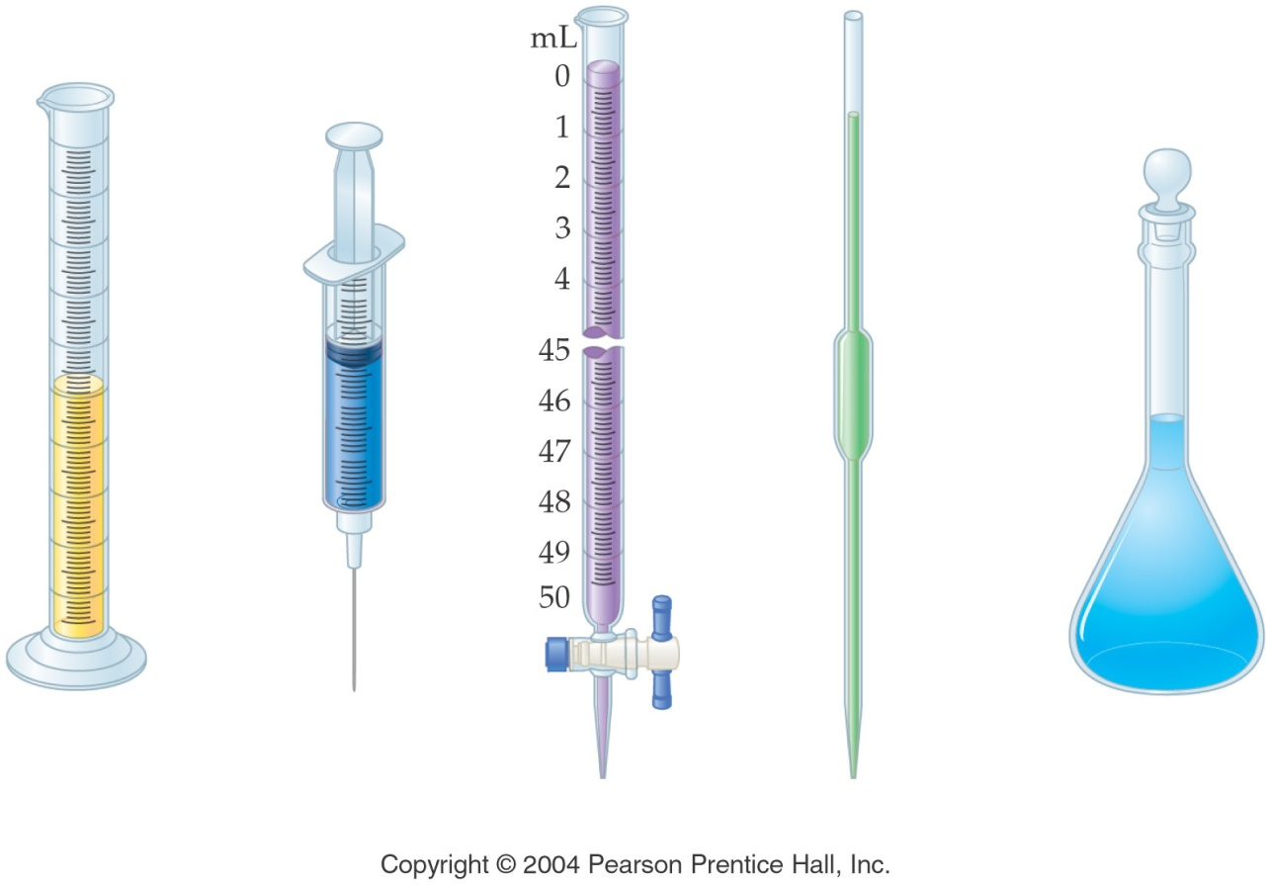
Volume Measurements
Volume is the amount of space occupied by a solid, liquid, or gas.
There are several instruments for measuring volume, including:
graduated cylinder
syringe
buret
pipet
volumetric flask

Slide 7
Significant Digits
Each number in a properly recorded measurement is a significant digit (or significant figure).
The significant digits express the uncertainty in the measurement.

Slide 8
Significant Digits /Figures
Significant digits are defined as ‘all certain digits plus the doubtful digit’.
The doubtful or uncertain digit is the last significant digit.

Slide 9
Rules to read number of Sig Figs
1 Measurements without zeroes are all significant i.e 2457
Leading zeros (the zeros that appear in the beginning of a number) i.e. 0.00456 are not significant and do not count.
Middle zeros always count significant i.e 2065
4. Tailing zeros are significant only if the measurement contains a decimal i.e 2.50

Slide 10
How many Significant Figs in a Measurement
Example 1
How many significant figures are there in the measured value 325?
a) 6
b) 5
c) 4
d) 3

Slide 11
How many Significant Figs in a Measurement
Example 2
How many significant figures are there in the measured value 36.000?
a) 6
b) 5
c) 4
d) 3

Slide 12
How many Significant Figs in a Measurement
Example 3
The number of significant figures in
8.6002 x 10⁻² g is
a) 3
b) 4
c) 5
d) 6

Slide 13
How many Significant Figs in a Measurement
Example 4
How many significant figures are there in the number 0.04560700?
a) 4
b) 5
c) 7
d) 8

Slide 14
Rounding Numbers
1. If the first non significant digit is less than 5, drop all non significant digits.
2. If the first non significant digit is greater than or equal to 5, increase the last significant digit by 1 and drop all nonsignificant digits.
3. If a calculation has two or more operations, retain all nonsignificant digits until the final operation and then round off the answer.

Slide 15
Rounding Numbers
A calculator displays 12.846239 and 3 significant digits are justified.
The first nonsignificant digit is a 4, so we drop all nonsignificant digits and get 12.8 as the answer.

Slide 16
Rounding Numbers
A calculator displays 12.856239 & let’s say 3 significant digits are justified.
The first nonsignificant digit is a 5, so the last significant digit is increased by one to 9, all the nonsignificant digits are dropped, and we get 12.9 as the answer.

Slide 17
Adding & Subtracting Measurements
When adding or subtracting measurements, the answer is limited by the value with the most uncertainty (least number of decimal places)
Let’s add three mass measurements.

Slide 18
Adding & Subtracting Measurements
106.7g
0.25g
0.195g
107.145g
The measurement 106.7 g has the greatest uncertainty (± 0.1 g).
The correct answer is 107.1 g

Slide 19
Adding & Subtracting Measurements
Example 5 :
What is the best answer to the following expression?
(56.68 cm + 0.816 cm + 2.8028 cm - 54.0 cm)
a) 6.2988 cm
b) 6.299 cm
c) 6.30 cm
6.3 cm

Slide 20
Multiplying & Dividing
The number of sig figs in the final answer are based on the measurement with the least number of significant figs.
Example 6:
Solve 2.568 cm x 0.550 cm
The final answer will be 1.41 cm².

Slide 21
Multiplying & Dividing
Example 7:
Solve 5.61 x 7.891 =
9.1
The final answer will be 4.9.

Slide 22
Exact Numbers
When we count something, it is an exact number.
Significant digit rules do not apply to exact numbers.
An example of an exact number: there are 3 coins on this slide.

Slide 23
Exponential Numbers
Exponents are used to indicate that a number has been multiplied by itself.
Exponents are written using a superscript; thus, (2)(2)(2) = 2³
The number 3 is an exponent and indicates that the number 2 is multiplied by itself 3 times. It is read “2 to the third power” or “2 cubed.”
(2)(2)(2) = 2³ = 8

Slide 24
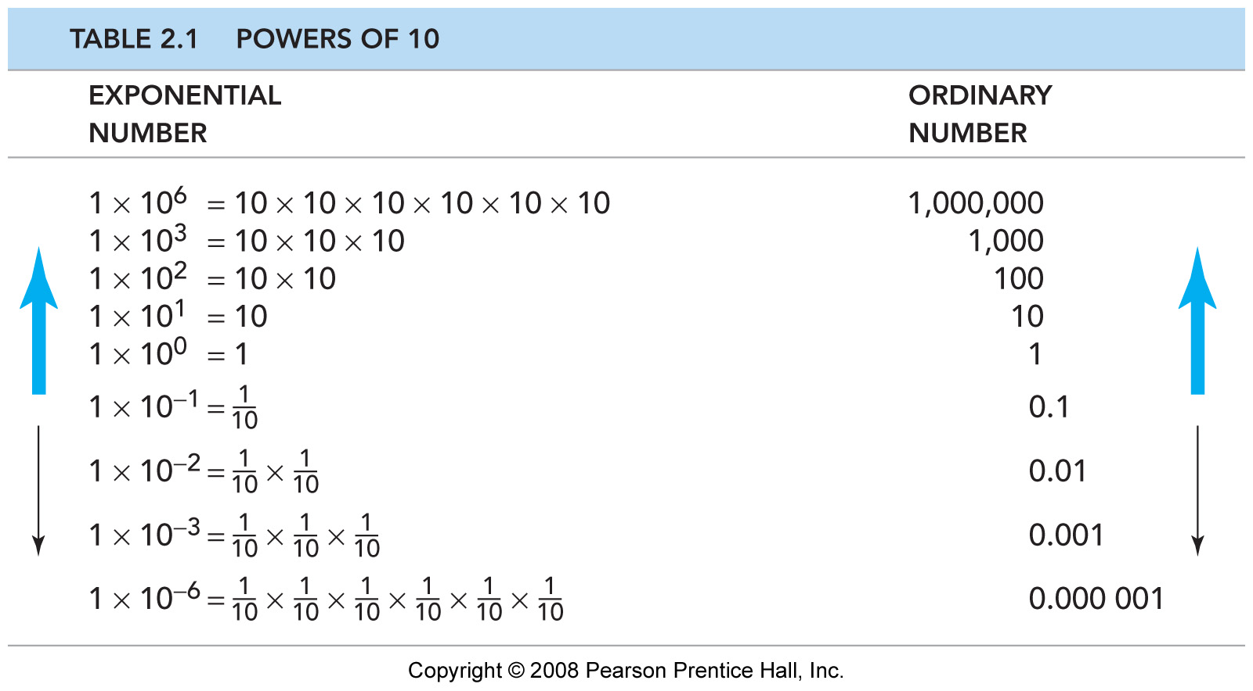
Powers of Ten
A power of 10 is a number that results when 10 is raised to an exponential power.
The power can be positive (number greater than 1) or negative (number less than 1).

Slide 25
Scientific Notation
Numbers in science are often very large or very small. To avoid confusion, we use scientific notation.
Scientific notation utilizes the significant digits in a measurement followed by a power of ten. The significant digits are expressed as a number between 1 and 10.

Slide 26
Applying Scientific Notation
To use scientific notation, first place a decimal after the first nonzero digit in the number followed by the remaining significant digits.
Indicate how many places the decimal is moved by the power of 10.

Slide 27
Applying Scientific Notation
A positive power of 10 indicates that the decimal moves to the left.
A negative power of 10 indicates that the decimal moves to the right.

Slide 28
Applying Scientific Notation
Example 1:
There are 26,800,000,000,000,000,000,000 helium atoms in 1.00 L of helium gas. Express the number in scientific notation.
Place the decimal after the 2, followed by the other significant digits.
Count the number of places the decimal has moved to the left (22). Add the power of 10 to complete the scientific notation.

Slide 29
Applying Scientific Notation
Example 2:
The typical length between two carbon atoms in a molecule of benzene is 0.000000140 m. What is the length expressed in scientific notation?
Place the decimal after the 1, followed by the other significant digits.
Count the number of places the decimal has moved to the right (7).

